Slide 1

Portfolio
by : Hamed Farrag
Data analyst

Slide 2


Hello
I'm Hamed Farrag,
About Me,
I am deeply passionate about data and numbers, and I aspire to leverage this passion as a data analyst to support individuals and companies in uncovering both the strengths and weaknesses in their performance.
By transforming raw data into clear insights and interactive visualizations through Power BI, I help decision-makers better understand their business dynamics and identify opportunities for growth.
My background as a sales manager in the pharmaceutical industry across Egypt and Libya has equipped me with strong business acumen, practical problem-solving skills, and a unique perspective that bridges data analysis with real-world market experience.
This combination allows me to deliver insights that are not only technically accurate but also strategically valuable.

Slide 3

Education
Faculty of science
2006
MBA in marketing
2022
Ain shams university , department of biology
from AAST , marketing as a major
Data analysis
2023
Power Bi specialist
2025
Challenger track data analysis from Udacity
Data analysis track specialized in Power Bi from DEPI

Slide 4



Personal
Skills
Through my extensive experience as a sales and marketing manager in the pharmaceutical industry, I have built a strong set of personal skills that I now apply in data analysis.
My role required advanced planning and organizing skills, ensuring that targets and strategies were effectively executed.
I developed strong analytical abilities to evaluate market trends, customer behaviour, and sales performance, which translates seamlessly into analysing complex datasets.
My communication skills allow me to present insights clearly to both technical and non-technical audiences, while my attention to details ensures accuracy and reliability in every analysis.
These combined skills enable me to approach data not only from a technical perspective but also with a strategic business mindset, delivering insights that drive informed decision-making and business growth.
Marketing
Planning
Analysis
Problem solver
Management

Slide 5

Technical
Skills
Data Analysis & Business Intelligence: Power BI (interactive dashboards, KPI tracking, DAX, Power Query), Excel (Pivot Tables, advanced formulas, Power Pivot).
Programming & Databases: SQL (complex queries, joins, aggregations), Python (Pandas, NumPy, Matplotlib, Seaborn for sales and market analysis)
Data Cleaning & Transformation: ETL processes, data wrangling, handling large datasets, ensuring data quality for decision-making
Statistical & Business Analysis: Market trend analysis, forecasting, hypothesis testing, regression analysis, customer segmentation
Reporting & Visualization: Designing business-focused dashboards and reports for stakeholders in sales and marketing, storytelling with data to support strategic decisions
Domain Knowledge (Pharmaceutical & Sales): Deep understanding of pharma market dynamics (Egypt & gulf ), sales performance analysis, territory management, marketing mix evaluation
Other Tools & Skills: Microsoft Office Suite (Excel, PowerPoint, Word), CRM systems, presentation skills, stakeholder communication, strategic insights
Microsoft excel
Python
SQL
Power Bi
Power Query

Slide 6

Work
Experience
Data Analyst freelancer
2025
Delivered sales dashboards, reports, and market insights to support business decisions.
Worked with stakeholders to align data analysis with marketing and sales objectives.
Helps individuals and companies specially in the pharmaceutical industry to redesign their strategies according to deep data analysis for ( HR , sales , marketing ) performance
Pharmaceutical sales manager
2005 - 2025
20 years in sales and marketing in the pharmaceutical industry.
Managed territories, sales teams, and product launches.
Applied data-driven strategies to improve sales efficiency.

Slide 7


Offered services
Data Cleaning & Preparation
Cleaning, and transforming raw data into usable formats.
Ensuring data accuracy and consistency for reliable insights.
Data Analysis & Insights
Conducting statistical and business analysis.
Identifying trends, patterns, and correlations to support decision-making.
Business Intelligence Dashboards
Designing interactive dashboards (Power BI, Excel, Tableau).
Visualizing KPIs and sales performance for management.
Sales & Marketing Analytics
Analyzing sales data to optimize territory management.
Market trend analysis, customer segmentation, and forecasting.
Reporting & Automation
Creating automated reports for recurring business needs.
Building Excel / Power BI solutions that reduce manual work.
Pharmaceutical Market Insights (Domain-specific advantage)
Leveraging pharma sales data to track product performance.
Supporting marketing strategies and competitive positioning.

Slide 8

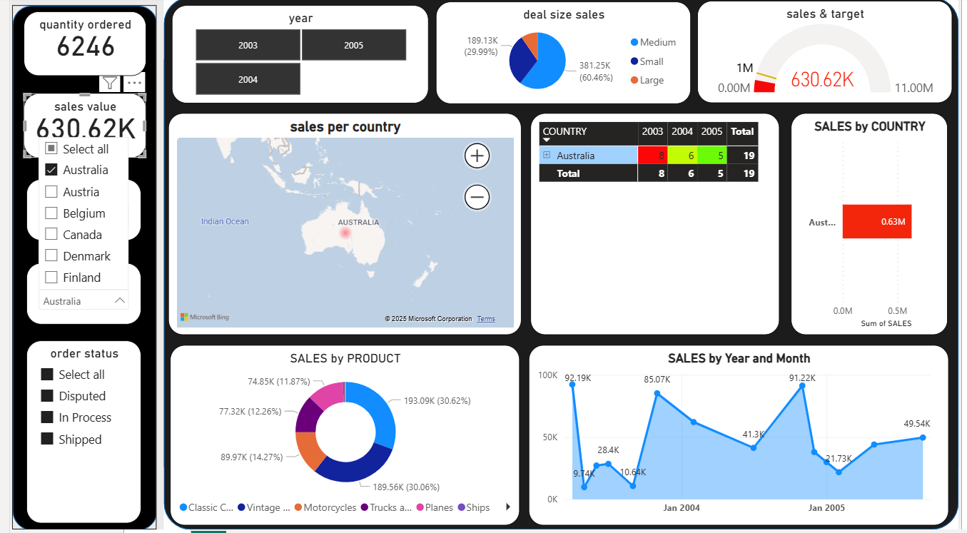
Project 1
Pharma Sales Dashboard – Power BI
Designed an interactive dashboard to track sales performance across regions.
Integrated KPIs (monthly growth, YoY comparison, top-performing products).
Helped identify underperforming territories and optimize resource allocation

Slide 9
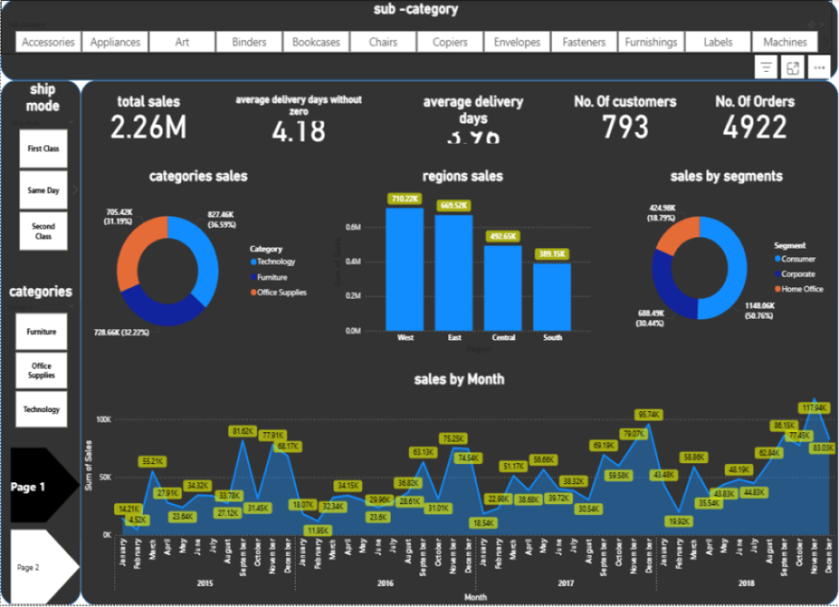
Project 2
Market Trend Analysis – Excel & SQL
Market Trend Analysis – Excel & SQL Extracted and cleaned sales data using SQL queries.
Built Excel models with PivotTables to forecast demand trends.
Presented insights that guided marketing campaigns and pricing strategy

Slide 10





Let’s Work
Together
01001260584
Hamedfarrag9@hotmail.com
Cairo , Egypt
www.linkedin.com/in/hamed-farrag

